Slide 1
Applying Lessons from the Curacao Marketing Application to ABC Healthcare's PMS Implementation
By, Neil Duraiswami
For the finals of CSC-581

Slide 2
Introduction
The development of the Curacao Marketing App project offers valuable insights and lessons that can be applied to ABC Healthcare's upcoming Patient Management System (PMS) implementation.
Despite the differences in domains, the challenges faced, strategies employed, and best practices adopted during the Curacao project hold significant relevance for the successful execution of the PMS project.
This presentation aims to highlight the key learnings from the Curacao Marketing App project and how they can be adapted to the PMS implementation.

Slide 3
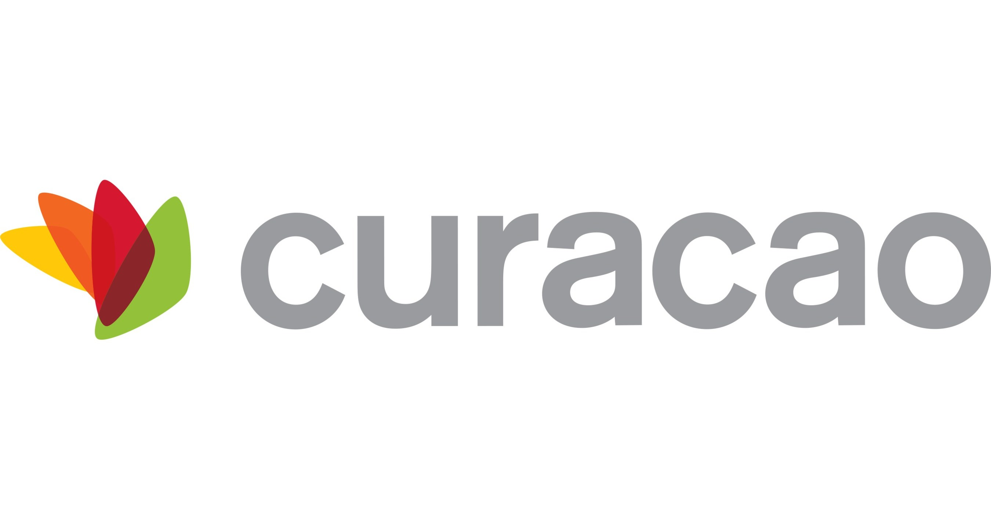
Requirement Analysis
Techniques:
Interviews, surveys
Use cases, user stories
Stakeholder Involvement:
Regular meetings, feedback
Challenges:
Understanding workflows
Clarifying requirements
Outcomes:
Clear, well-defined requirements

Slide 4
Agile Methodology
Iterative Development:
Created a prototype within a week, allowing early feedback.
Task Division and Team Collaboration:
Initially divided into subgroups for data categorization and front-end development, later restructured into groups for specific functionalities.
Stakeholder Feedback:
Regular meetings to gather and clarify feedback.
Flexibility and Adaptability:
Adapted to stakeholders' preference for Microsoft Power Apps.

Slide 5
Risk Management
Potential Risks:
Unclear requirements
Changing technology
Feedback misunderstandings
Mitigation Strategies:
Iterative approach
Continuous stakeholder engagement

Slide 6
Integration and Challenges
Data Integration:
One team categorized and structured data from Excel sheets for compatibility with the new application.
Technical Skill Gap:
Upskilled team members in Microsoft Power Apps to rebuild the prototype effectively.
Stakeholder IT Support Requirements:
Developed the application in Microsoft Power Apps to ensure familiarity for the IT support team.

Slide 7
Testing Strategy
Types of Testing:
Unit Testing: Verified individual functionality of each module.
Integration Testing: Ensured compatibility between different modules.
User Acceptance Testing (UAT): Involved the marketing team to validate usability and functionality.
Execution:
Integrated testing activities into each Agile sprint cycle.
Continuous unit and integration testing, with UAT sessions at the end of each sprint.

Slide 8
Project Management, Role and Contribution
Testing Coordination: Prioritized and executed testing tasks within each sprint.
Quality Assurance: Advocated thorough testing practices, ensuring alignment with project objectives.
Communication and Reporting: Facilitated communication between the development team and stakeholders, providing visibility into testing progress and outcomes.

Slide 9
Scalability and Future Growth
Cloud-Based Infrastructure: Utilized Azure for scalable compute and storage resources.
Microservices Architecture: Developed application components as independent services.
Database Sharding: Horizontally partitioned database for improved performance and scalability.

Slide 10
User Training and Change Management
Training Workshops: Conducted interactive workshops for hands-on experience.
User Documentation: Provided comprehensive manuals, guides, and FAQs.
Pilot Testing and Feedback: Involved users in real-world testing to gather feedback and make adjustments.

Slide 11
Relating to ABC Healthcare Case Study
Requirement Analysis: Techniques like interviews and surveys will be invaluable for understanding diverse stakeholder needs.
Agile Methodology: An iterative approach and consistent stakeholder engagement will help ensure alignment with user needs.
Risk Management: Mitigation strategies can be applied for unclear requirements, changing technology, and feedback misunderstandings.
Integration Challenges: Dedicated teams for data integration and technical skill development will be key.
Testing Strategy: Comprehensive and iterative testing will validate functionality and usability.
Scalability: Architectural decisions for cloud infrastructure, microservices, and database sharding will support future growth.
User Training: Workshops and documentation will ensure a smooth transition and user adoption.

Slide 12
Conclusion
The successful implementation of the Curacao Marketing App project provides a robust framework that ABC Healthcare can leverage for its Patient Management System (PMS) implementation. By adopting a structured requirement analysis, Agile methodology, comprehensive risk management, and thorough testing strategies, ABC Healthcare can ensure a seamless integration and scalable solution. Additionally, focusing on user training and change management will facilitate a smooth transition, empowering users and fostering stakeholder engagement. These best practices will help ABC Healthcare navigate challenges and achieve a successful, future-proof PMS implementation.

Slide 13
Thank You!!

